Slide 1
Networks and Internet
Sara T. Sheikh

Slide 2
We will explore……
Computer Networks
Transmission Technology
Network Types
Network Hardware
Network Topology
Cloud Computing
Bit Streaming

Slide 3
Computer Network Models
The Issue:
  Networks are complex systems with many components
  Hardware (cables, routers, switches)
  Software (protocols, applications)
  How do all these pieces work together?
Solution: Networking Models
  Organize networking functions into logical layers
  Each layer has specific responsibilities
  Layers work together to enable communication
  Standard framework everyone follows
    OSI Model - 7 layers
    TCP/IP Model - 4 layers

Slide 4
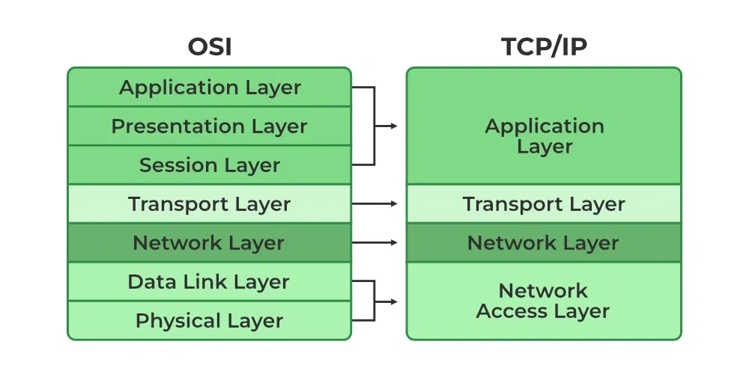
OSI Vs. TCP/IP Model

Slide 5
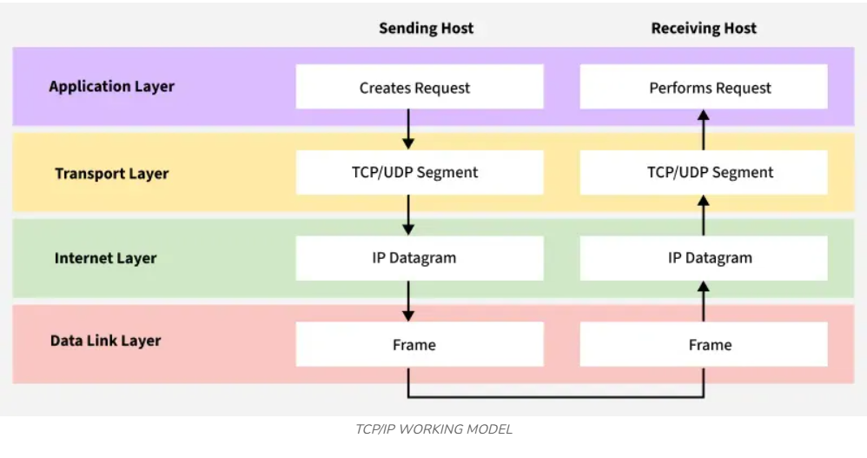
TCP/IP

Slide 6
How TCP/IP Connects All
Concept | TCP/IP Layer Connection | Explanation
Packetization | Transport Layer & Internet Layer | Transport layer breaks data into segments; Internet layer adds IP headers to create full packets (the structure we studied).
IP Addressing | Internet Layer | IP addresses identify source and destination; routers read these addresses and forward packets accordingly.
Network Hardware | Different Layers | Routers operate at the Internet Layer (IP addresses); switches operate at the Network Access Layer (MAC addresses); cables/Wi-Fi handle physical transmission.
Overall Idea | TCP/IP Model | TCP/IP organizes how data is packaged, addressed, transmitted, routed, and delivered.

Slide 7
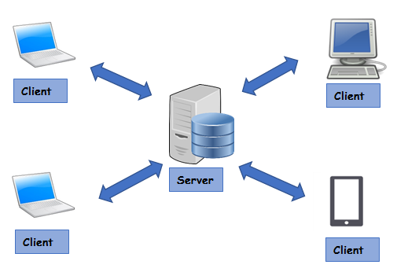
Network Models : Client - Server

Slide 8
Benefits & Drawbacks
Benefits | Drawbacks
Easier central management | Single point of failure - if the server goes down, services could be unavailable
Scalability: new clients can be added easily | It can be expensive to set up and maintain - often need dedicated teams of people to maintain them
Higher reliability as resources are managed centrally

Slide 9
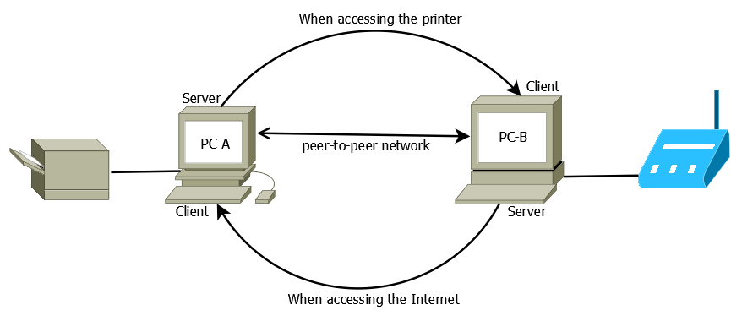
Network Models : Peer-to-Peer

Slide 10
Benefits & Drawbacks
Benefits | Drawbacks
Easy to set up and less expensive than client-server as no administrative staff are needed | Lack of central control can lead to security issues and vulnerabilities
No dependency on a central server | Not suitable for large networks as it can have performance issues
Data can be shared directly between systems without the need for a central server

Slide 11
When to use a client-server network
The choice between client-server and peer-to-peer depends on the specific needs and resources of the network in question
Security, cost, ease of setup, and maintenance requirements should be considered

Slide 12
Network Topology : Bus
A bus topology is all devices connected by one single ‘bus’ cable, terminated at each end
The terminators stop the signal bouncing back and causing errors
A bus topology works by each device:
  ‘Listening’ to electrical signals
  Checking data packets for their specific address
  Ignoring data packets it does not recognise
A bus topology has been replaced by much more efficient network topologies such as the star topology

Slide 13
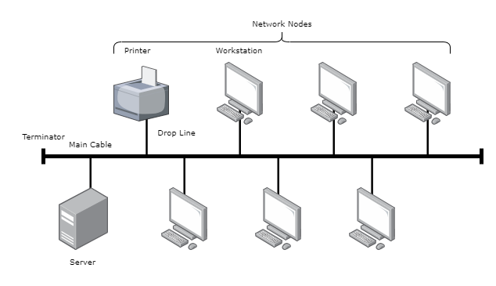
Network Topology : Bus

Slide 14
Network Topology: Star
A star topology has a central switch which all other devices connect to
A switch is an intelligent device which ensures that traffic only goes to the intended device
A star topology is commonly seen in most homes, businesses, organisations and schools

Slide 15
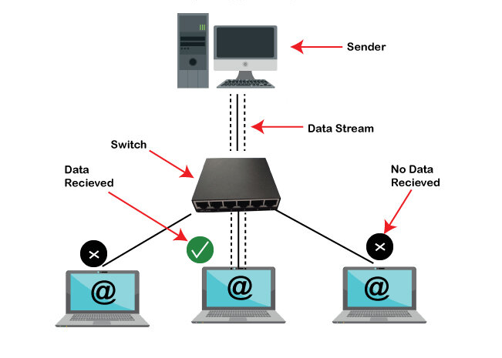
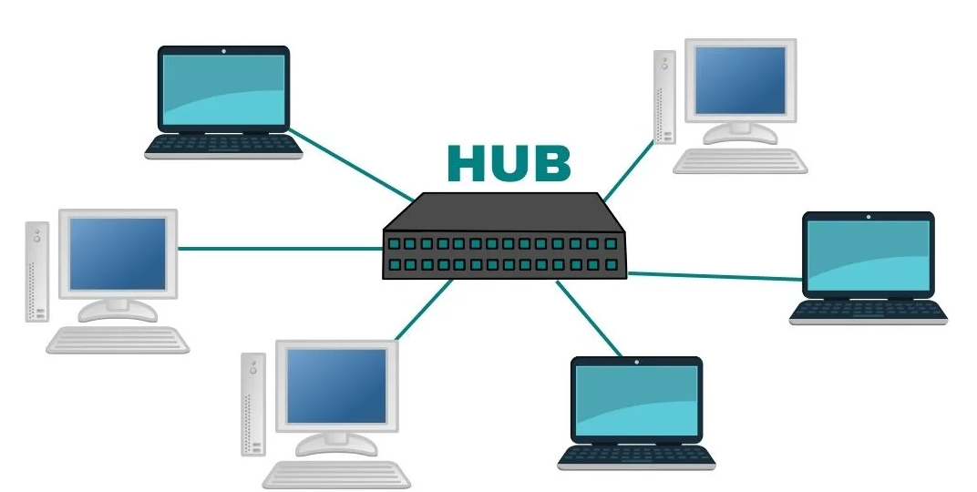
Network Topology: Star
A hub will send traffic to all devices on the network, if the address in the packet matches a device it will be accepted, otherwise it is ignored.
  A switch will only send traffic to devices on the network where the address in the packet is a match

Slide 16
Network Topology: Mesh
A mesh topology allows all computers to be connected to all other computers
This is known as a full mesh network topology
LANs can make use of mesh networks however, they are more commonly seen in IoT devices such as wearable technology and smart home devices

Slide 17
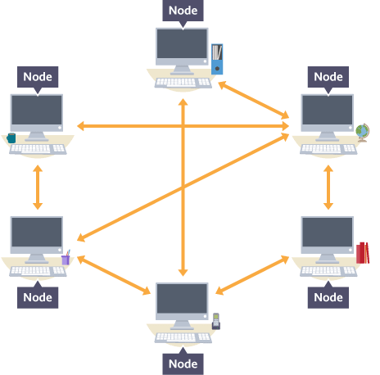
Network Topology: Mesh
Traffic (packets) on a mesh topology can follow two different methods:
  Routing - devices are given routing logic (act like a router) to ensure packets are sent to the correct device in the shortest route
  Flooding - all packets are sent to all devices using no routing logic, this can lead to network flooding causing performance issues

Slide 18
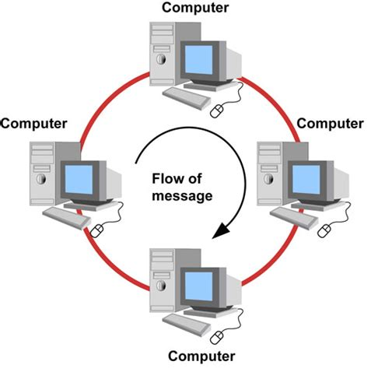
Network Topology : Ring
It forms a ring connecting devices with exactly two neighboring devices.
A number of repeaters are used for Ring topology with a large number of nodes, because if someone wants to send some data to the last node in the ring topology with 100 nodes, then the data will have to pass through 99 nodes to reach the 100th node.
Hence to prevent data loss repeaters are used in the network.

Slide 19
Network Topology: Hybrid
A hybrid topology is a mix of two of more different network topologies
For example, bus & star, star & mesh etc
A typical use of a hybrid topology would be when there is a need to join different networks together
Imagine a large education trust takes over three schools: School A, School B, and School C.
  School A uses a bus topology to connect classroom computers with a simple shared cable
  School B uses a star topology to link all devices to a central switch in the IT room
  School C uses a mesh topology to make sure every building (e.g. science block, library) stays connected, even if one cable fails

Slide 20
Network Topology: Hybrid
When the trust wants to connect all three schools into a single network, it uses a hybrid topology
This allows:
  Each school to keep its own existing setup (bus, star, or mesh)
  The schools to be linked together efficiently
  Easy expansion, such as adding a new school or admin office without changing everything
  The network to be more flexible and reliable, using the strengths of each topology

Slide 21
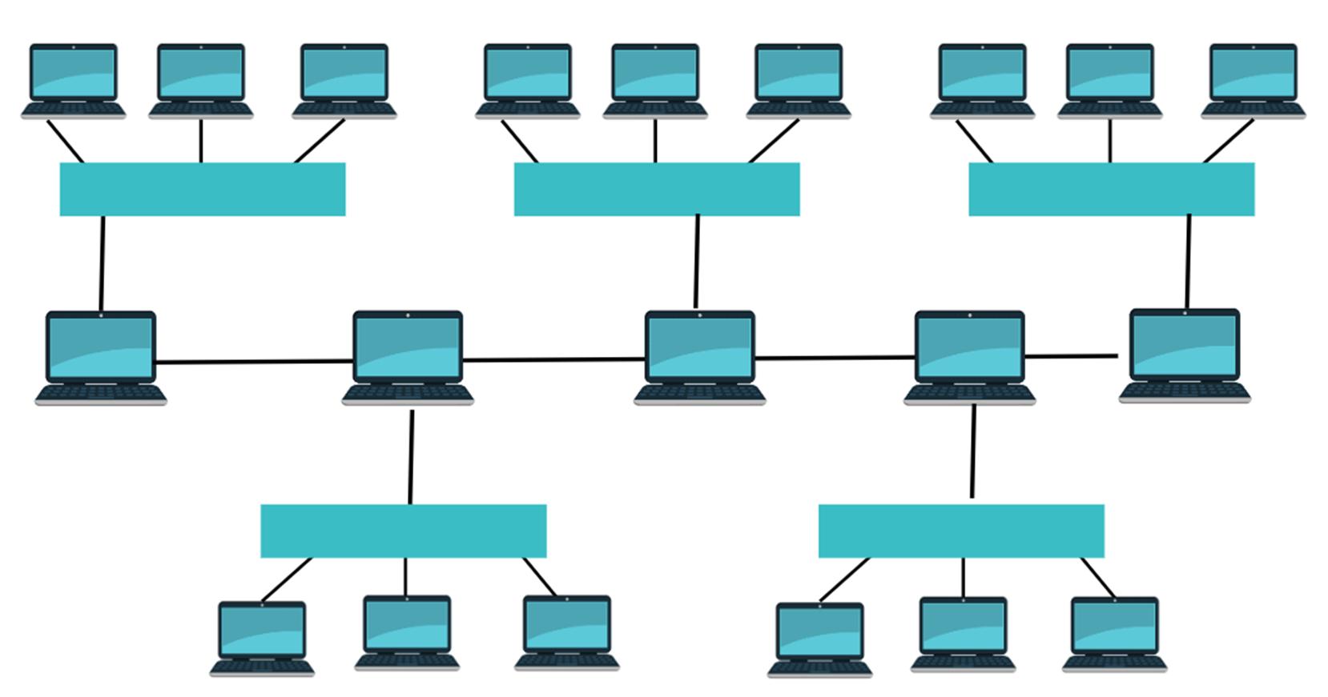
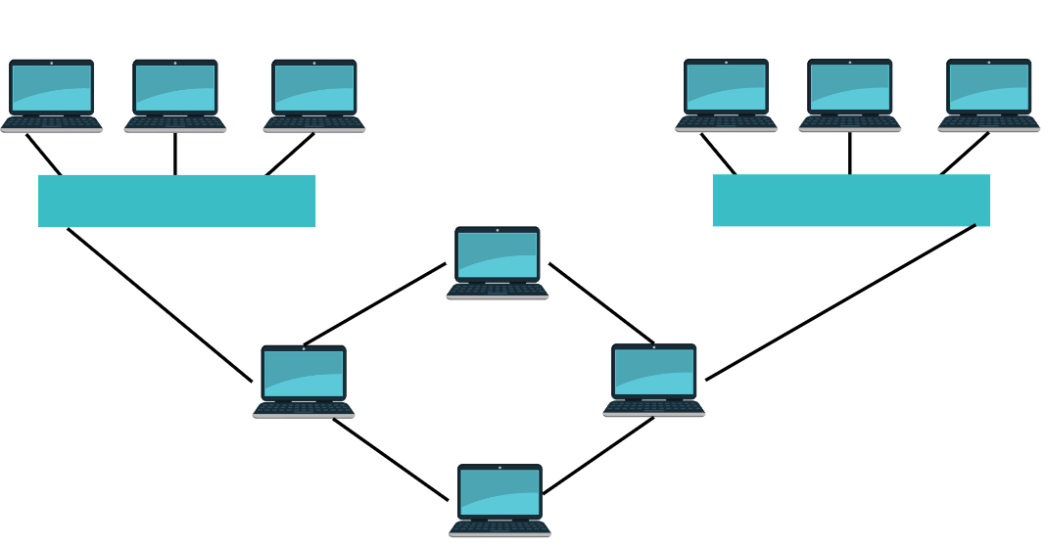
Examples
Star – Bus Topology
Star – Ring Topology

Slide 22
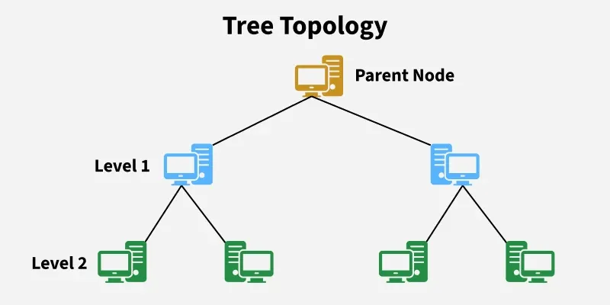
Network Topology : Tree

Slide 23
Selection of Topology
Choose a network topology based on your needs: applications, distance, performance, existing hardware, physical space, and your IT team’s skill level.
Set a realistic budget that covers hardware, cabling, installation, and maintenance—advanced topologies cost more but offer higher performance.
Consider reliability: simple topologies work for small, non-critical setups, while hospitals, banks, and large systems require more robust options like mesh or hybrid.
Plan for scalability by selecting a topology that can grow with your organization and support more devices in the future.
Ensure proper implementation—experienced vendors can prevent configuration errors and help build a stable, long-lasting network.

Slide 24
Problem 1
SM@RT Co., a tech company, is analyzing the costs and capacities of two different network setups: client-server and P2P for its workers.
  Company has 60 employees and every employee connects to 5 peers in a P2P network. To connect every employee to the P2P network, company needs $300.
  For a client-server setup, each employee is connected to the central server. 1 server can handle 50 employees at maximum and costs $3000. Per employee set up cost is $400.
Estimate the capacity and setup cost of both the networks to decide which is better.
How will the cost and capacity of both setups if the company doubles in terms of the number of employees?

Slide 25
Problem 2
A small office uses a star topology with 8 computers connected to a central switch.
  How many network cables are needed?
  How many ports must the switch have?
  How many ports are needed on each computer?
In a star, each device has a separate cable to the central switch.
  Cables = number of devices = 8 cables
  Switch must have one port per device - 8 ports
  Each computer only needs 1 network port, because it connects to the switch with one cable.

Slide 26
Problem 3
Six devices are connected in a bus topology along a single main cable.
  How many cable segments between devices are needed (ignore drop cables/terminators)?
  How many ports are needed on each device?
Devices are connected one after another along a single line.
Between 6 devices you need 5 links:
  cables=𝑛−1=6−1=5
Each device connects to the bus with 1 port (one NIC), so 1 port per device.

Slide 27
Problem 4
Two departments each use a star topology with 10 computers connected to a local switch. The two switches are then connected together (forming a small hybrid network).
How many cables are needed in total?
How many ports are required on each departmental switch?
Within each department: 10 computers - 10 cables to its switch.
Two departments - 2×10=20 cables to computers.
Switch–switch link - 1 extra cable.
Total cables = 20+1=2120+1=21.
Ports on each departmental switch:10 ports for its computers + 1 port for the inter-switch link = 11 ports per switch..

Slide 28
Cloud Computing

Slide 29
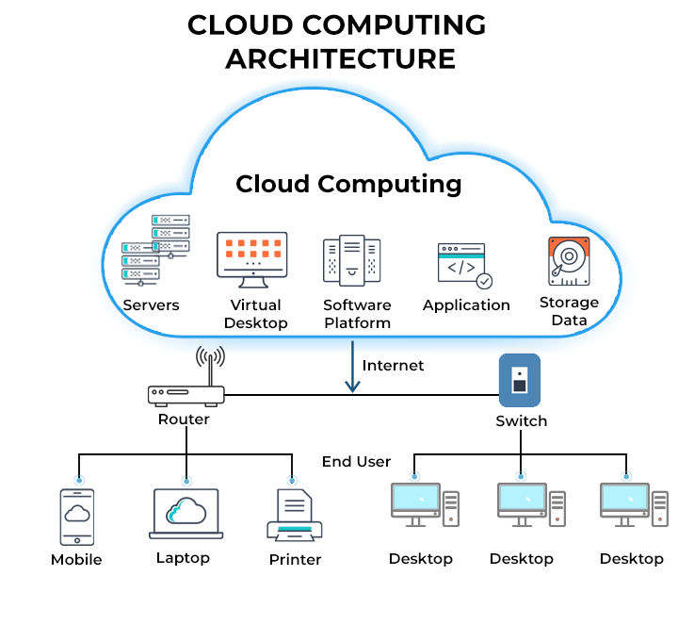
Cloud Computing
Cloud computing is when software, services or files are hosted entirely on remote servers
Accessed through the internet
The two most common cloud computing examples are:
  Cloud storage
  Cloud software

Slide 30
Cloud Storage
Cloud storage is long-term storage of data that resides in a remote location
Accessible only via the Internet (WAN)
Data is stored on remote servers in data centres
Storage is usually on HDDs (magnetic) but increasingly SSDs (solid state)
Examples include: Google Drive, Dropbox, OneDrive

Slide 31
Cloud Software
Cloud software is hosted and managed remotely
The user accesses the software online (on demand)
The provider handles:
  Maintenance
  Upgrades
  Security
Typically paid for via a monthly fee or yearly subscription
Examples include: Google Docs, Microsoft 365, Adobe Creative Cloud

Slide 32
Network Hardware

Slide 33
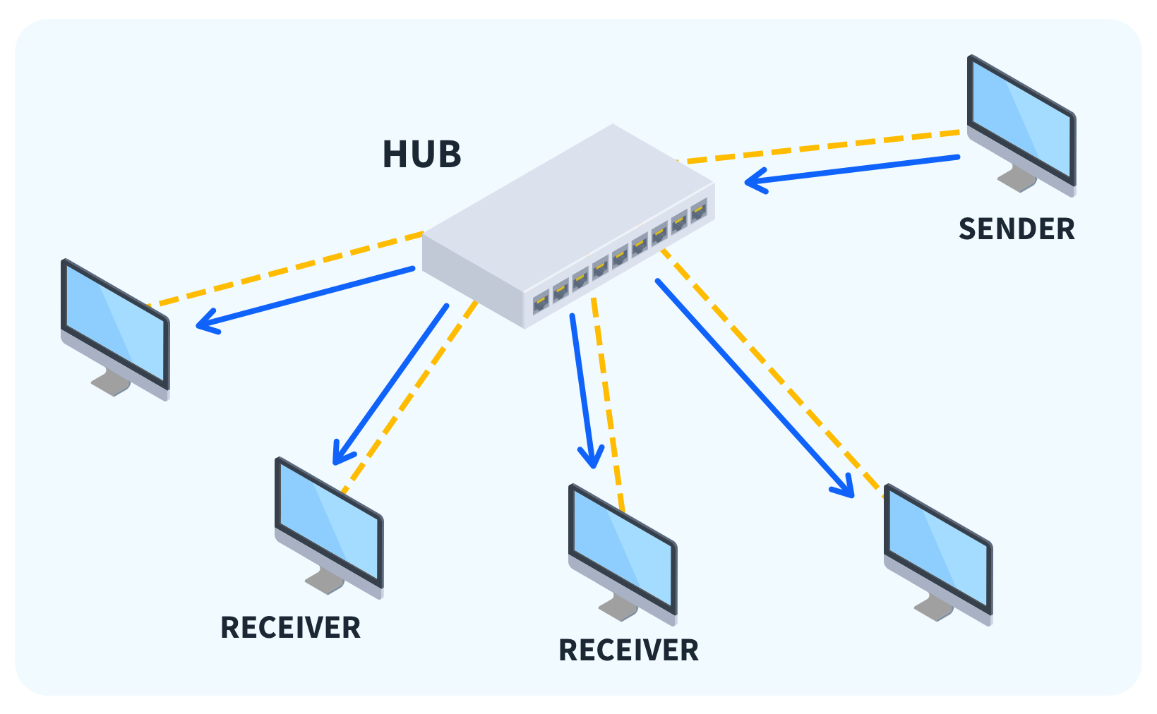
LAN Hardware - Hub
A hub is a networking device which is used to connect multiple devices in a network
Hubs are "dumb" devices that pass on anything received on one connection to all other connections
Because all data is sent to all devices, it can lead to network inefficiencies and security issues
Hubs allow multiple other devices to be connected to them

Slide 34
LAN Hardware - Hub
Hubs are generally much cheaper than switches, but:
  When a hub receives a data packet, it will broadcast it to every device on the network
This creates two potential issues:
  As the information is being broadcast to every device, it will make unnecessary traffic, especially if there are a large number of devices
  As every device will receive the data packet, security may be a concern

Slide 35
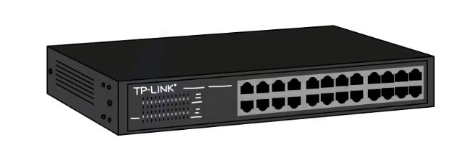
LAN Hardware - Switch
A network switch is a networking device that connects devices on a computer network and uses packet switching to receive, process and forward data to the destination device
Unlike a hub, a switch only sends data to the device it was intended for, which improves network efficiency

Slide 36
LAN Hardware - Switch
When a switch receives a data packet, it examines the destination MAC address and looks up that address in its lookup table
Once it has found the matching MAC address, it will then forward the data packet to the corresponding port
Port | Mac address
1 | DF-42-B2-11-4D-E3
2 | 11-14-F2-1D-C3-C6
3 | 00-4B-17-7C-A2-C9

Slide 37
Servers
A server is a powerful computer that provides services or resources to other devices on a network (called clients)
Can manage and store files, host websites, control access to printers, or run applications
Often kept in dedicated rooms or data centres due to their importance and high uptime requirements
Designed to handle multiple requests at once and stay on 24/7
Servers usually run specialist operating systems (e.g. Windows Server, Linux)
Can be part of a LAN (local server) or accessed remotely over a WAN (cloud server)
Examples include: file server, print server, web server, mail server

Slide 38
Network Interface Card (NIC)
Historically a card inserted into a slot on the motherboard but now more likely to be built into the motherboard, that enables a device to connect to a network
NICs have a built-in ethernet port and can be connected to a network via an ethernet cable
It provides a dedicated, full-time connection to a network, converting the computer's data into a network-friendly format
Every NIC has a unique identifier called a MAC address, used to identify the device on the network
The primary function of a NIC is to send and receive data packets between the computer or device and the network

Slide 39
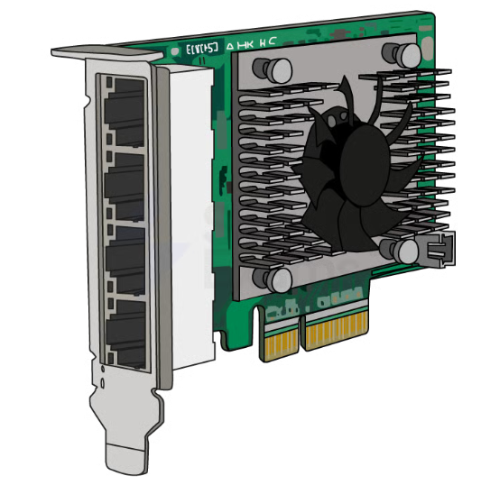
Network Interface Card (NIC)

Slide 40
Wireless Network Interface Card (WNIC)
Allows a device to connect to a wireless network (Wi-Fi)
Often built into the motherboard of modern laptops, tablets, and smartphones
Uses radio waves to send and receive data to/from a wireless router or access point
Provides a dedicated connection to the network, without needing physical cables
Supports standard wireless protocols like Wi-Fi 4, 5, or 6 depending on the model
Has a unique MAC address used to identify the device on the network
Converts the device’s data into a wireless signal suitable for network transmission

Slide 41
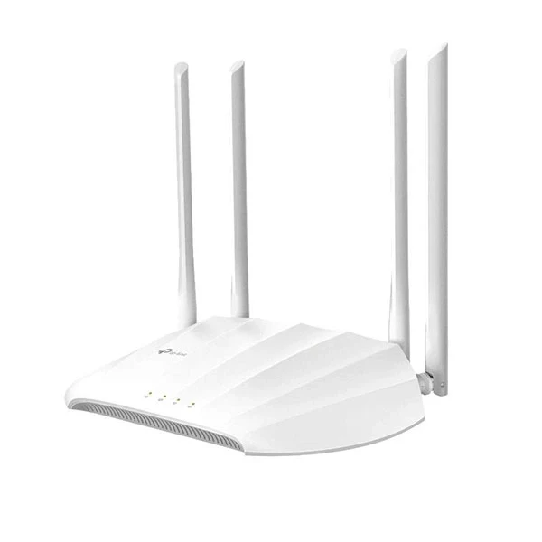
Wireless Access Point (WAP)
Allows wireless devices to connect to a wired network
Acts like a bridge between the wired and wireless parts of a network
Commonly found in homes, schools, and offices as part of a Wi-Fi setup
Often built into wireless routers, but can also be a separate device in larger networks
Uses radio signals to send and receive data from wireless devices (e.g. laptops, phones)
Extends the range of the wireless network, especially in large buildings
Supports communication using standard Wi-Fi protocols (e.g. 802.11ac, 802.11ax)

Slide 42
Bridge and Repeaters
Bridge
  Connects two separate network segments so they function as one larger LAN.
  Operates at the Data Link Layer (Layer 2) and filters traffic using MAC addresses.
  Reduces unnecessary network traffic by only forwarding data when needed.
Repeater
  Regenerates and boosts weak signals to extend the range of a network.
  Operates at the Physical Layer (Layer 1) of the OSI model.
  Ensures data can travel long distances without losing quality.

Slide 43
Role of Routers
A router is a network hardware device that routes data from a local area network (LAN) to another network connection - it joins two networks together
Routers analyse data packets and determine the best path for the packet to reach its destination
  The header contains information about the packet
  The payload is the actual data being sent
  The IP address of both the sender and intended recipient is stored in the header of the data packet

Slide 44
Role of Routers
The router can often feature additional functionalities such as wireless networking, built-in firewalls for enhanced security, and network switch capabilities
A router being used to connect a LAN to a WAN will have a public IP address, which has been assigned to it by an Internet Service Provider
It is this public IP address that other routers use to identify and direct packets to the network

Slide 45
Role of Routers
If the data packet is coming into the LAN, the router will send the data packet to the specific device within its LAN that the packet is meant for
If the packet is being sent from a device within the LAN, it will read the header of the packet to determine the intended destination IP address
It might have to travel through several routers before it gets to its destination
  Each pass from router to router is called a hop
  It will then forward the packet to its destination
The network access device or ‘home hub’ used in your home network will have a router built into it

Slide 46
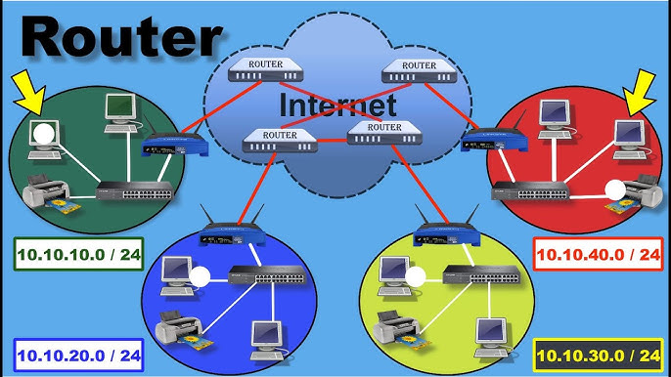
Role of Routers

Slide 47
Steps
Step | Description
1 | A router receives incoming data packets from one network and analyses the packet header to determine the destination IP address
2 | It then looks up the IP address in a routing table (routing table of known networks) to determine the next network where the packet should be sent
3 | The router then forwards the packet to the appropriate network or device

Slide 48
Other Functions
Assigning IP addresses to devices within the LAN
Filtering incoming traffic based on certain criteria, such as IP address, port number, or protocol type

Slide 49
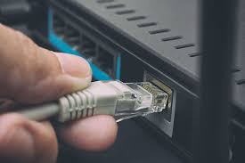
Ethernet
Ethernet is a wired networking standard used in LANs.
It defines how devices send and receive data over cables.
Data is transmitted in small units called frames.
Each frame includes source & destination MAC addresses.
Ethernet uses CSMA/CD to detect and avoid collisions.
It ensures reliable communication through error checking (FCS – Frame Check Sequence).

Slide 50
Ethernet Frames
Data is transmitted across the network in structured units called frames
Each frame typically includes:
  Preamble – A sequence of bits used to synchronise communication between devices
  Destination MAC Address – The unique ID of the device the data is being sent to
  Source MAC Address – The unique ID of the device sending the data
  EtherType / Length – Indicates the type of data or the size of the payload
  Payload – The actual data being sent (e.g. a web page, file, or message)
  FCS (Frame Check Sequence) – Used for error detection to check if data arrived correctly

Slide 51
CSMA/CD
CSMA/CD helps Ethernet networks avoid and handle data collisions.
Devices listen to the cable first (“Carrier Sense”) to check if it is free.
If free → they transmit; if busy → they wait (“Multiple Access”).
If two devices transmit at the same time → a collision happens and is detected (“Collision Detection”).
Devices stop, send a jamming signal, wait a random time, and try again.

Slide 52
Bit Streaming
Bit streaming is the continuous flow of data (bits) sent over the internet or a network
Commonly used for real-time services like video, audio, or live broadcasts
Data is sent in small chunks so it can be played back immediately
Reduces the need to download the entire file before use
Bit streaming can be categorised into two types:
  Real-time
  On-demand

Slide 53
Real – Time Vs. On-Demand
Feature | Real-time streaming | On-demand streaming
What is it? | Watching something live as it happens | Watching something whenever you choose
Examples | Live sports, live news, online gaming, video calls | Netflix, YouTube, Amazon Prime
Timing | Streamed and watched at the same time | You choose when to watch
Delays (latency) | Needs low delay to feel live | Can handle small delays thanks to buffering
Internet needed | Needs a strong and steady connection | Can adjust quality based on your connection (adaptive bitrate)
Playback controls | Usually no pause or rewind during live events | You can pause, rewind, or skip as needed

Slide 54
Network Types
Geographical Scope

Slide 55
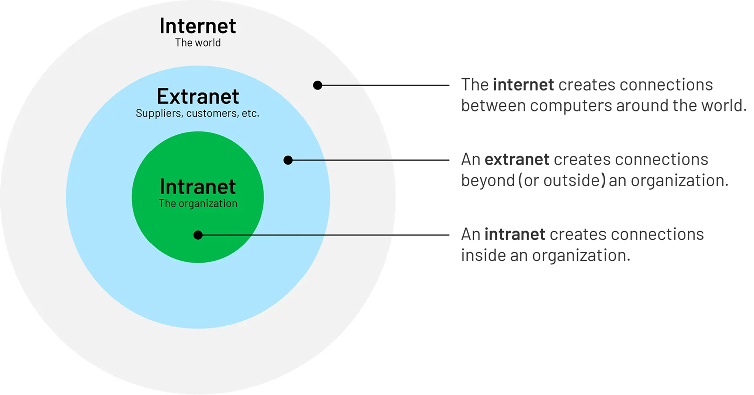
Geographical Scope

Slide 56
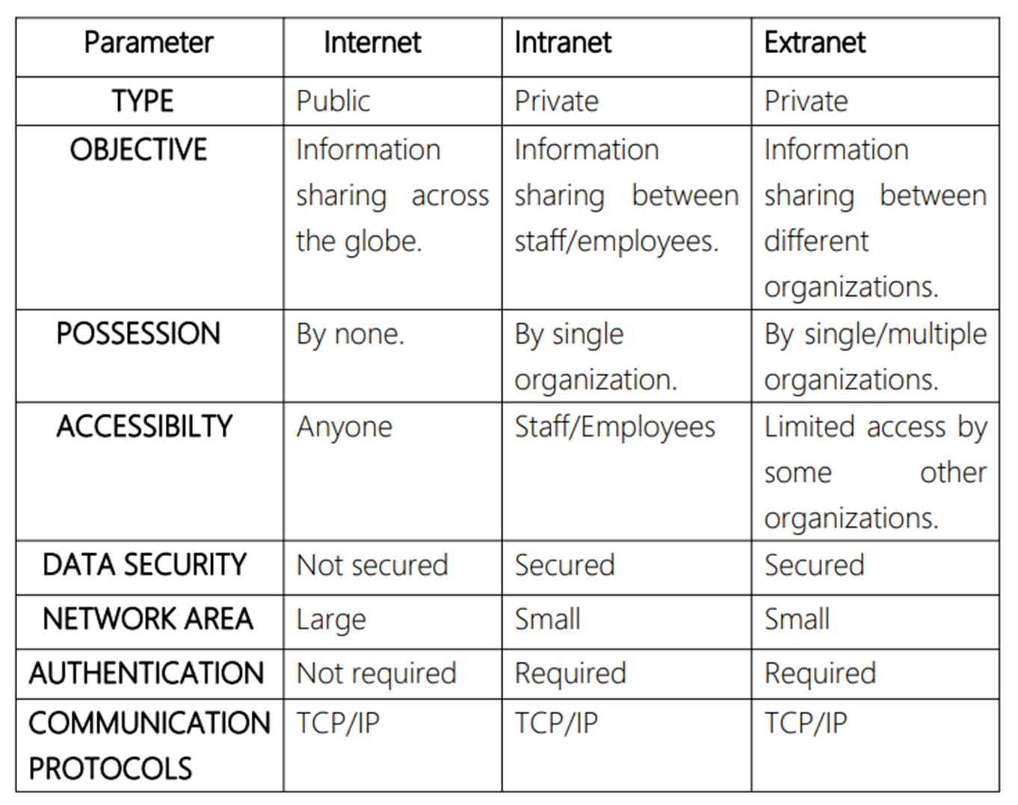
Important Parameters

Slide 57
Class Activity
Draw a hybrid topology with a star backbone and three ring networks.
Differentiate between bus and line topology.
In a mesh topology, four devices are arranged to form the mesh.
  How many cables will be needed? How many ports are needed for each device?
  If the mesh now contains six devices, how many cables will be needed? How many ports are needed for each device?

